Slide 1



12.D EDITING NETWORK CONFIGURATION FILES
modify network configuration by editing configuration files

Slide 2


ssh command
[user01@localhost ~]$ vim /etc/sysconfig/network-scripts/ifcfg-name
[user01@localhost ~]$ nmcli con reload

Slide 3
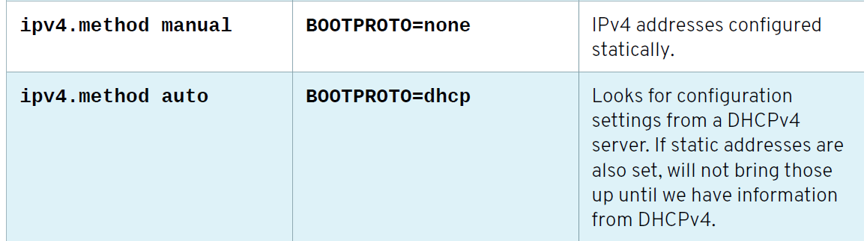


Slide 4
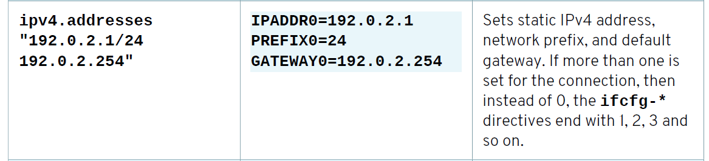

Slide 5
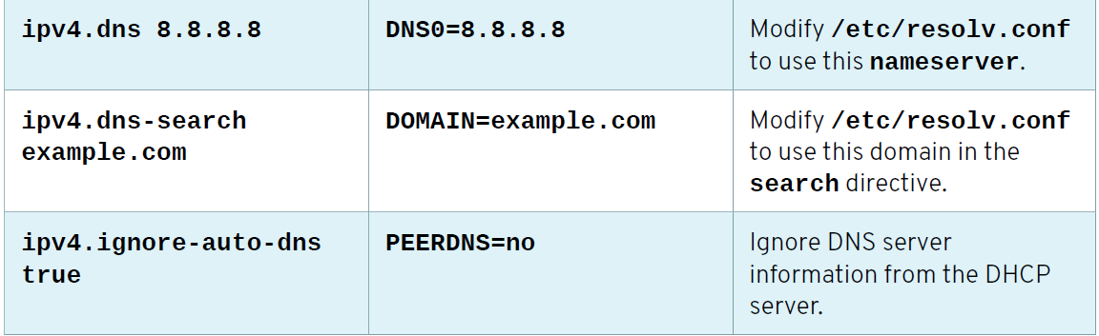

Slide 6
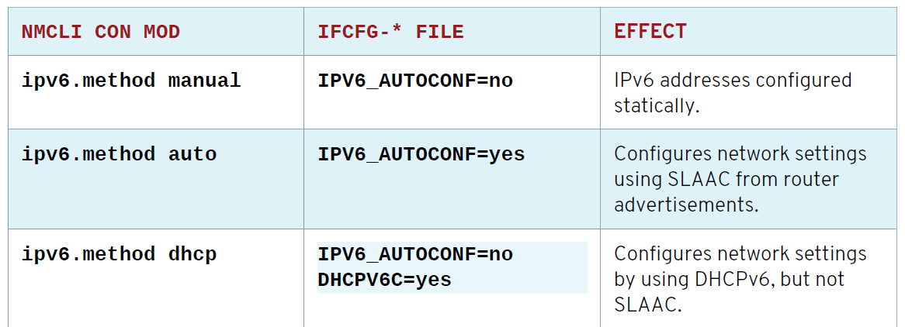

Slide 7
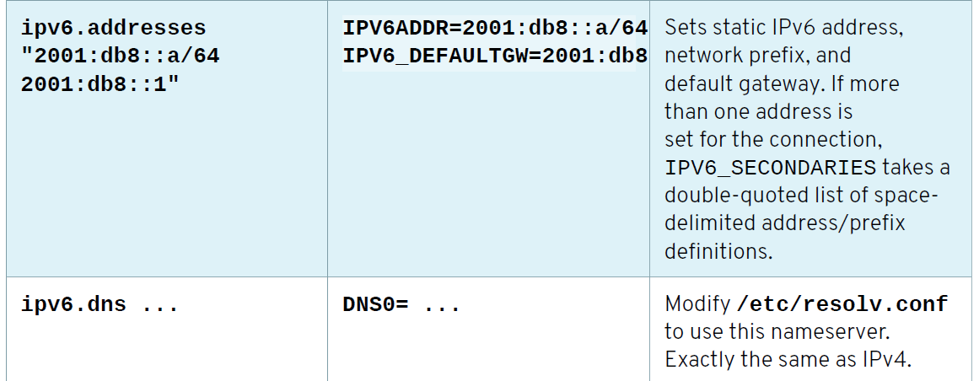

Slide 8
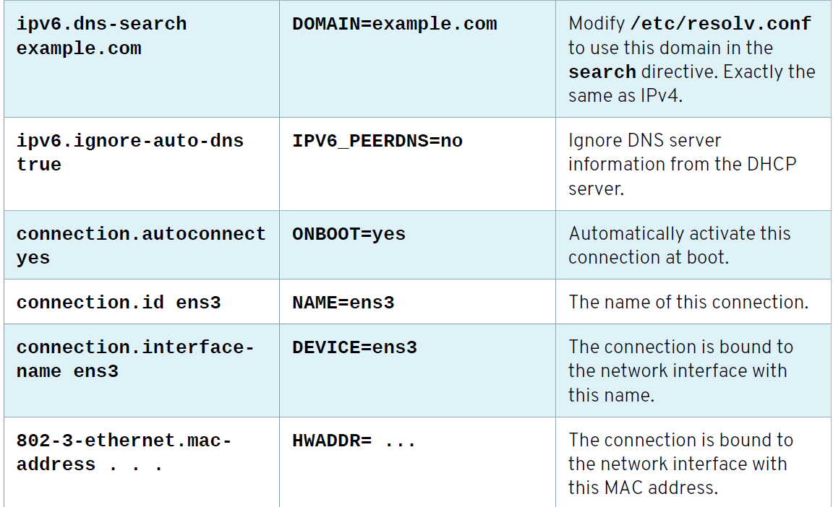

Slide 9
run nmcli con reload to make NetworkManager read the configuration changes. The interface still needs to be restarted for changes to take effect.
[root@host ~]# nmcli con reload
[root@host ~]# nmcli con down "static-ens3"
[root@host ~]# nmcli con up "static-ens3"

